Slide 1
Agentic RAG: Multi Document Chatbot using MCP
Presented By:
Sunil Varma Patchamatla

Slide 2
Agent Architecture
Ingestion Agent
MCP Message Based
Communication
Parses Multiple Documents & Creates the Chunks
Each agent communicates via structured message passing
Retriever Agent
Uses Faiss Vector DB & retrieves the relevant chunks based on the query
User Interface
Powered Streamlit
LLM Response Agent
Uses OpenAI model for response generation using relevant chunks

Slide 3
System Flow
1. User Interface
2. Ingestion Agent
Uploads Documents & User Query
Loads multi-format docs
Chunks with text splitter
4. LLM Response Agent
3. Retrieval Agent
Formats prompt with context
Generates final response
Builds FAISS Vector Store
Encodes chunks as embeddings
Retrieves top-k matches
5. User Interface
Final answer shown
Source chunks shown

Slide 4
Tech Stack Used
Framework: LangChain (document loaders, chunking, llm, and prompts)
Frontend UI: Streamlit (Simple and interactive web interface)
Language Model: ChatGPT-4o-Mini from OpenAI (response generation)
Vector DB: FAISS (Efficient similarity-based document retrieval)
Embedding Model: HuggingFace BAAI/BGE Small (Converts chunks into dense vectors)
Agent Communication: Model Context Protocol (Custom message passing between the agents)

Slide 5
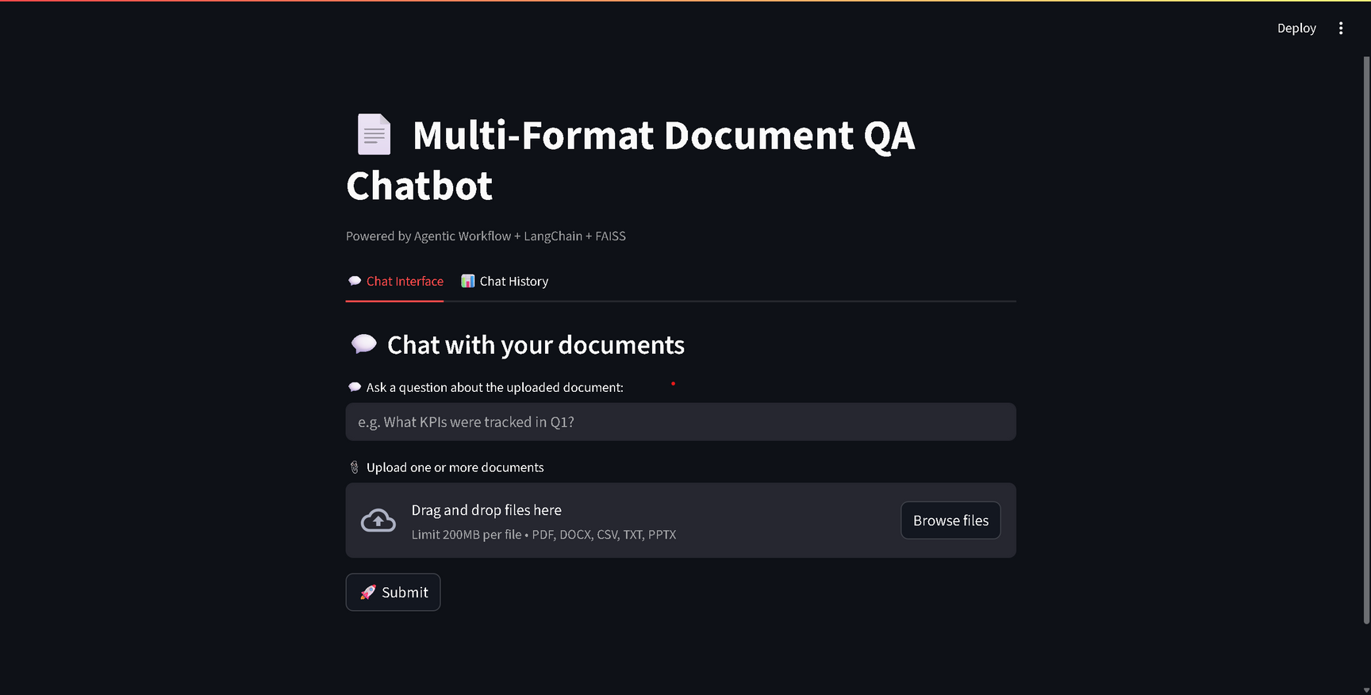
UI Screenshots
The chat interface with user query and multi-format document upload
Your paragraph text

Slide 6
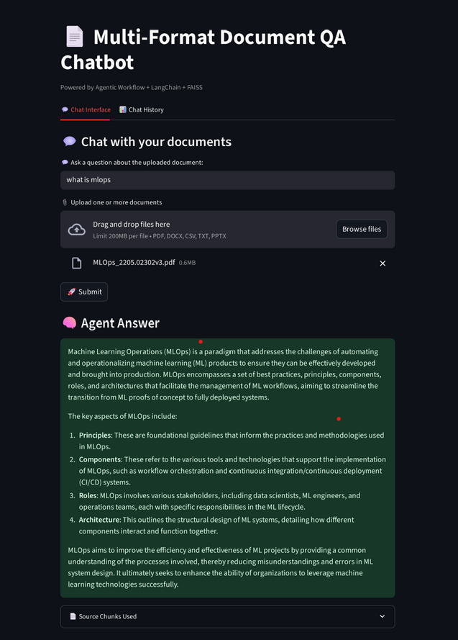
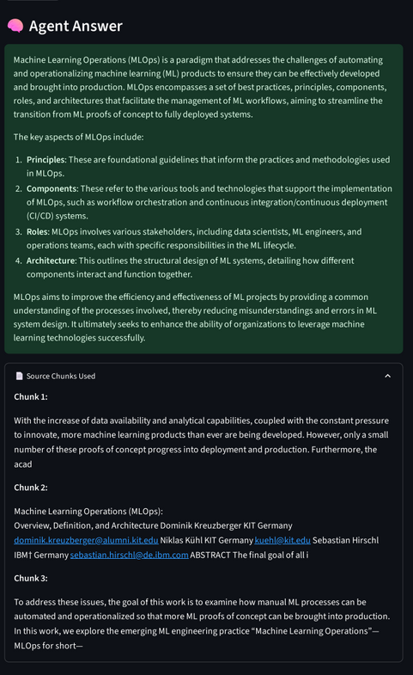
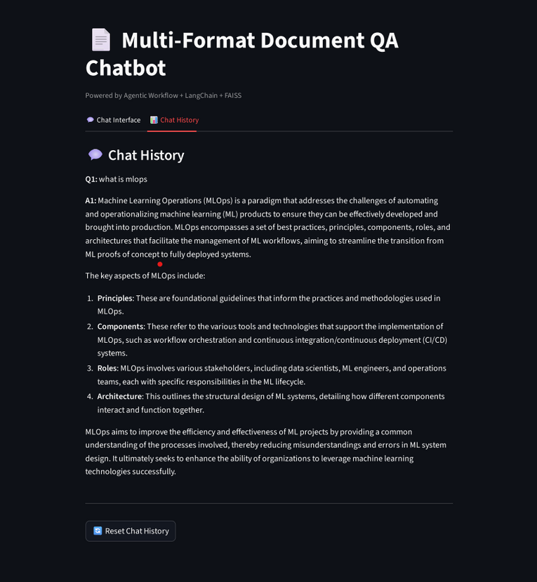
UI Screenshots
The response generated using the query and uploaded document.
The source chunks are also being displayed after the response generation.
The chat history is also being displayed in another tab and uses it for contextual responses.

Slide 7
Challenges Faced
1. Designing the MCP:
Creating a flexible yet simple protocol for message structure, traceability, and communication across agents.
2. Managing Agent Routing:
Ensuring correct message dispatch and sequencing (Ingestion → Retriever → LLM → User) using the Coordinator Agent.
Temporarily Managed the routing between agents using the MCP messages in the Streamlit UI.
3. Multi-Format Document Ingestion:
Handling multiple file formats (pdf, docx, csv, pptx, txt) with different loaders.
Ensuring all documents are parsed into usable text chunks.

Slide 8
Future Improvements
1. Persistent Vector Store for Reusability:
Currently, the vector store is built fresh on every query.
Add persistent FAISS/ChromaDB storage to retain document embeddings for future queries.
2. Multilingual Document QA:
Use multilingual embeddings + LLM to support documents in different languages.
3. Deploy as a Scalable Backend Service:
Wrap agents inside a FastAPI server.
UI communicates via API for scalability and production readiness.
4. Improved Chunking per Document Type:
Use semantic-aware splitters specific to each document type to preserve context and coherence.
Leads to better retrieval relevance and LLM response accuracy.

Slide 9
Thank you very much!
Presented by
Sunil Varma Patchamatla

